Slide 1
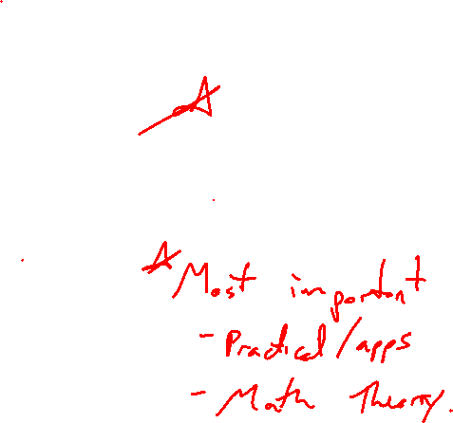
Chapter 2 Functions
Introduction
Notes:
Most important idea of this class (mathy, practical)

Slide 2
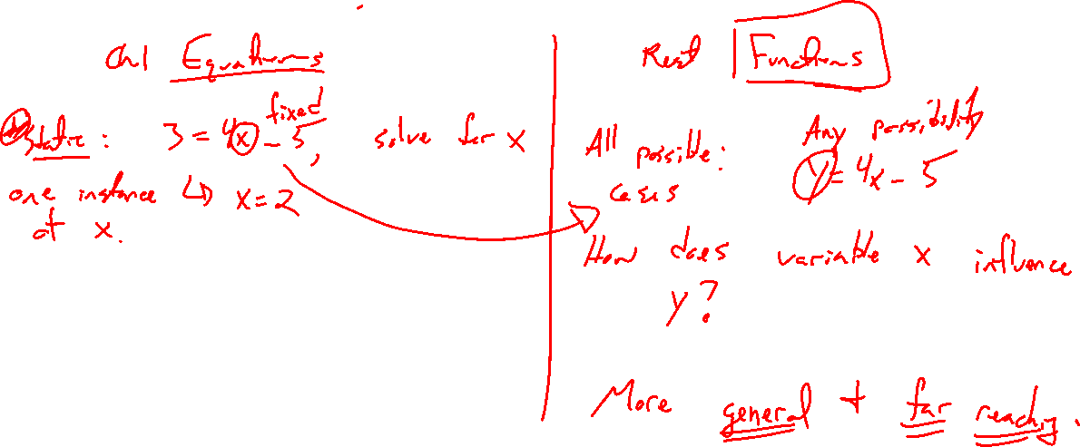
Equations Compared to Functions
Notes:
Static: Solve 3=4x-5 for x
All cases: Study y=4x-5 for all (x,y), as x changes how is y influenced?
Key is generalization, thinking of this equation as an action performed on input x to generate output y.

Slide 3
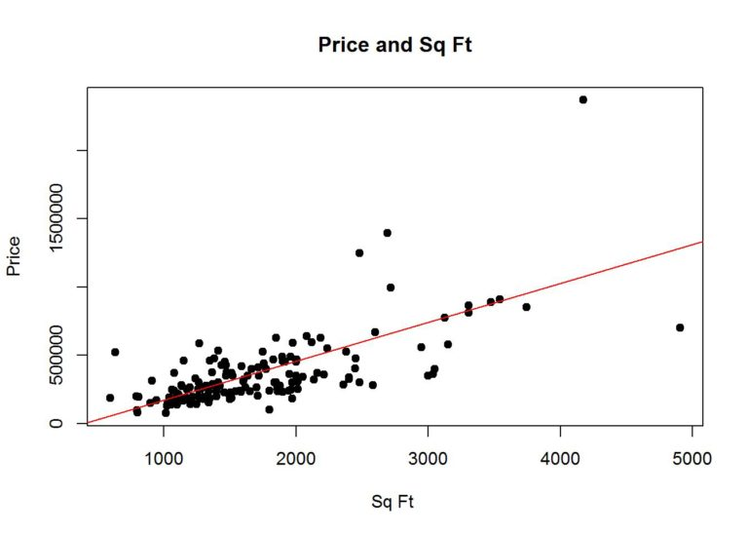
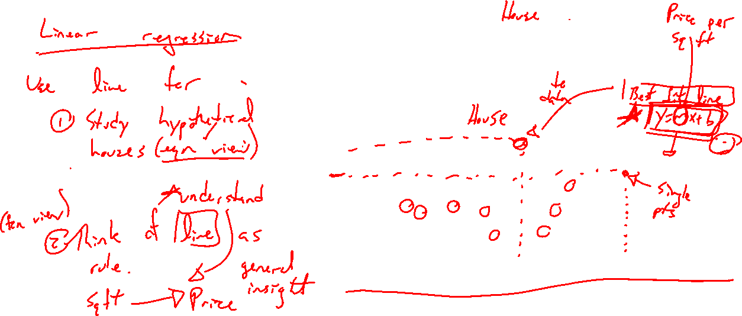
Motivation: House Data and Fitting Functions
Notes:
Linear regression: best fit line, plane, points, distance, etc from Chapter 1
Instead of thinking of line as a way to study points (static situations / houses), think of the line as a general rule. Now we study that rule as a whole.

Slide 4
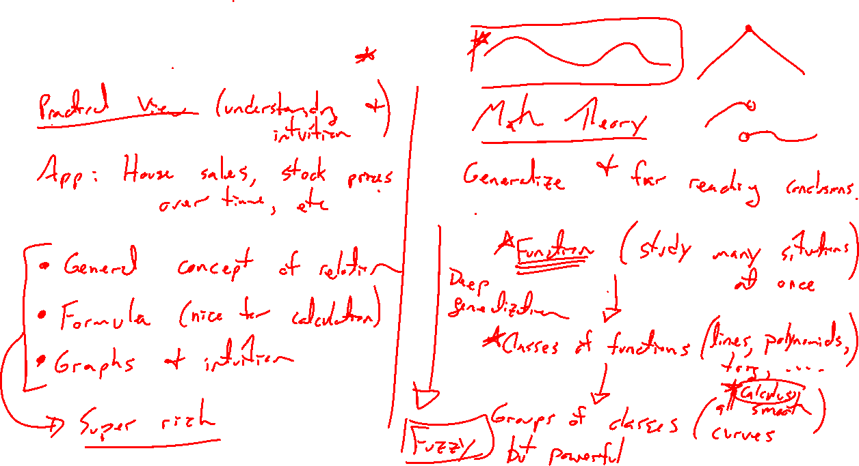
Power of Functions
Notes:
Practical: Describe a phenomenon (house sales, La cross population over time, etc) as a...
- General rule (conceptual), formula (calculation), graph (intuition), super rich discussion
Math Theory foundation:
- Study many situations at once (classes of functions, lines, polynomials, exp; large groupings, smooth, continuous)
- Calculus is built on this, all smooth functions
- More general makes for fuzzy understanding, but far reaching

Slide 5
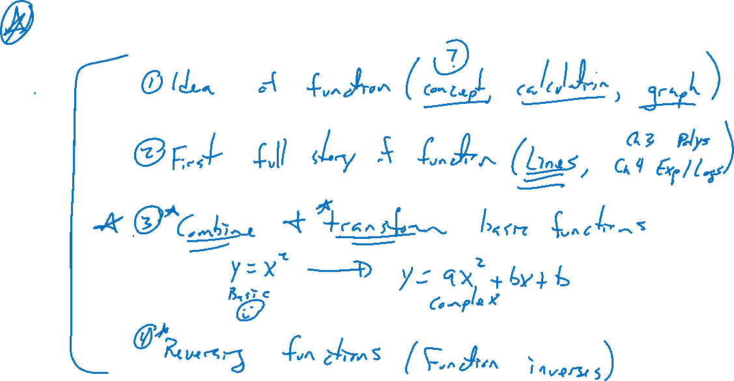
Outline of Chapter
Notes:
Idea of functions (concept, visualize)
First full function story (linear, quad/poly/rationals in chp 3, exp/logs in chp 4)
Combing / transforming simple functions to harness complexity
Reversing functions (inverses)

Slide 6
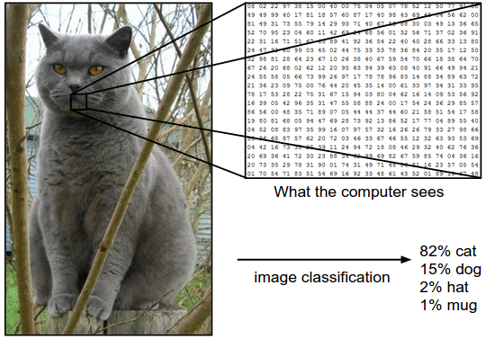
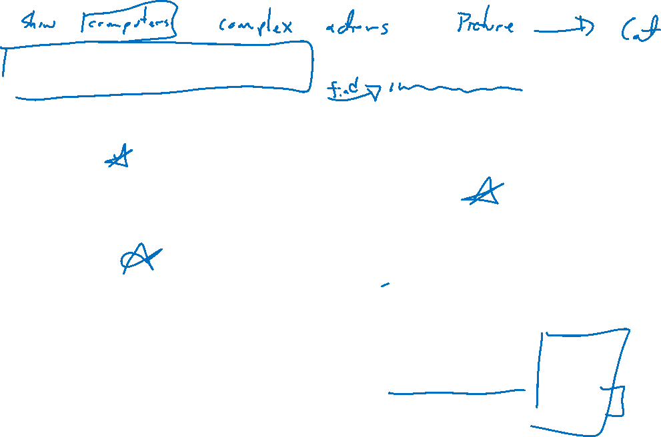
Machine Learning and Functions
Notes:
Real world is complex, how to find a function that represents it?
Classification: Cat, bird, bird song,
Forecasting: Stock market, covid
Many more

